Slide 1
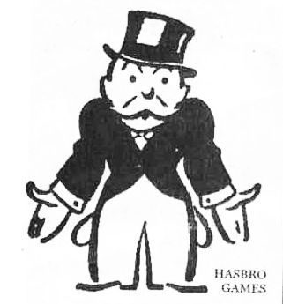
Budget Cuts and You Exploring new cost-cutting opportunities and sources of funding

Slide 2
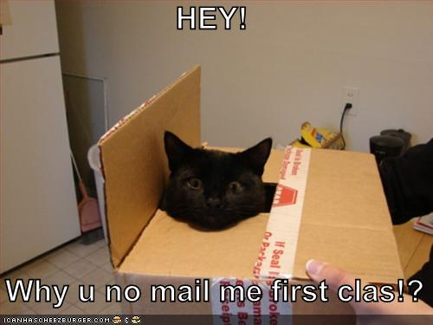
Personal Mail
No personal mail sent to department

Slide 3
Email Migration
Cheaper alternative to email and calanders
>>

Slide 4
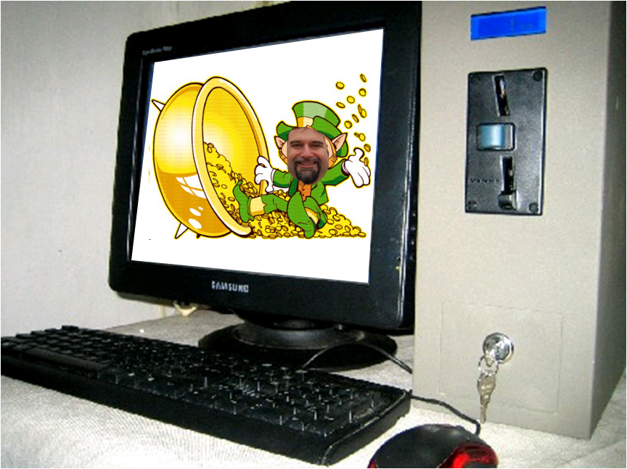
Coin Operated Computers
Reduce Power Consumption

Slide 5
Presentation Will Terminate in…
INSERT COIN
2
1
3
4
0
5

Slide 6
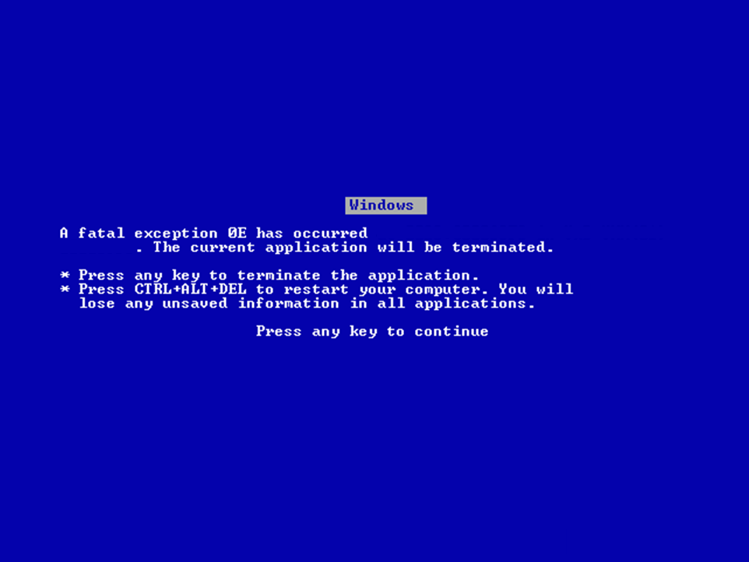
because you did not insert
a quarter

Slide 7
Coin Operated Computers
Reduce Power Consumption

Slide 8
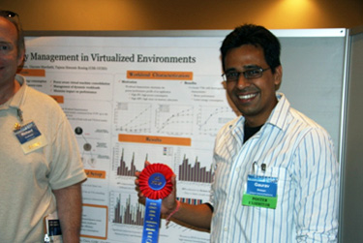
Cross Promotional Opportunities
Explore exciting new ways of reaching out to corporate sponsors!
Product placement
Naming rights

Slide 9
Cross Promotional Opportunities
New Clothing Attire

Slide 10
Cross Promotional Opportunities
Bringing Extensibility to Verified Compilers
Zachary Tatlock & Sorin Lerner

Slide 11
Cross Promotional Opportunities
Bringing Extensibility to Verified Compilers
Zachary Tatlock & Sorin Lerner
Presented by

Slide 12
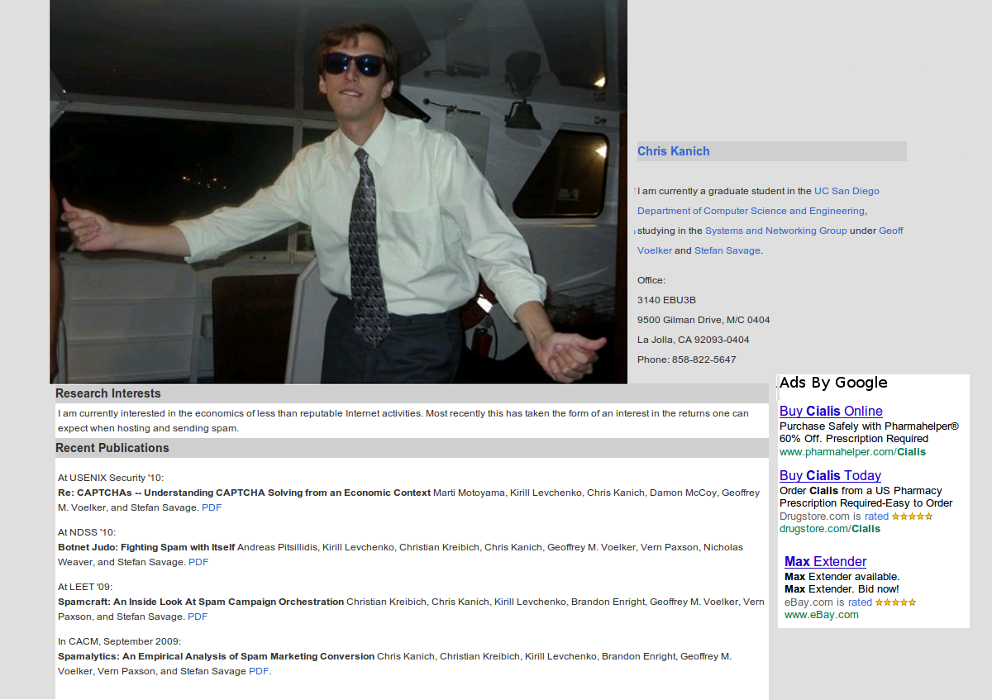
Cross Promotional Opportunities
AD-Sense on webpages

Slide 13
Cross Promotional Opportunities
AD-Sense on webpages

Slide 14
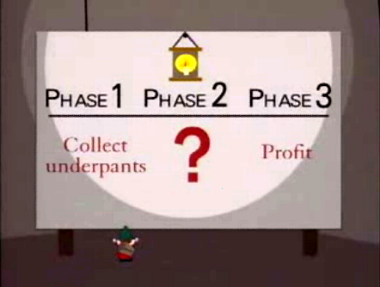
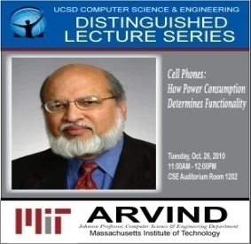
Distinguished Lecture Series
Step 1: Speakers present
Step 2: ?????
Step 3: Profit

Slide 15
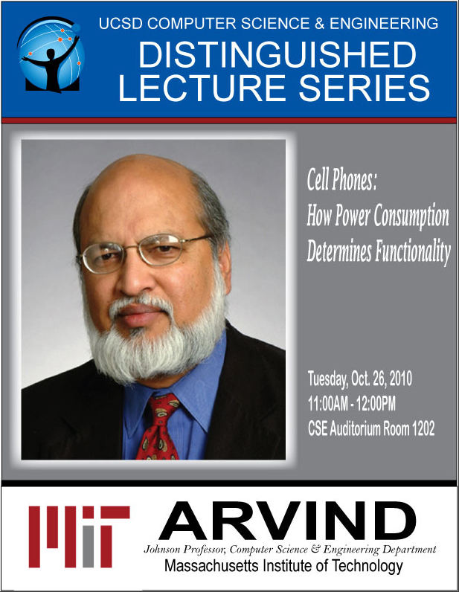

Slide 16
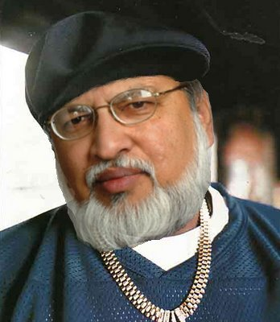
Pagers.
ARVIND

Slide 17
231 Is A
Joke/
It Takes
A Nation
Of
Millions
To Understand
Our Hacks
public static
void enemy
{}

Slide 18
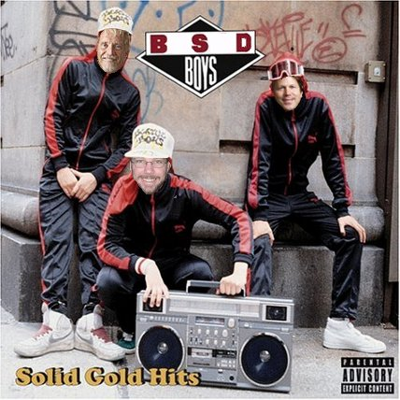
helo
Brooklyn
BSD Boys

Slide 19
99
Problems
With
Electronic
Voting
J-Hovav

Slide 20
Conclusion
Reduce Spending
Increase Profit
Funky beats

