Slide 1
First Annual misc@cs.ucsd.edu awards

Slide 2
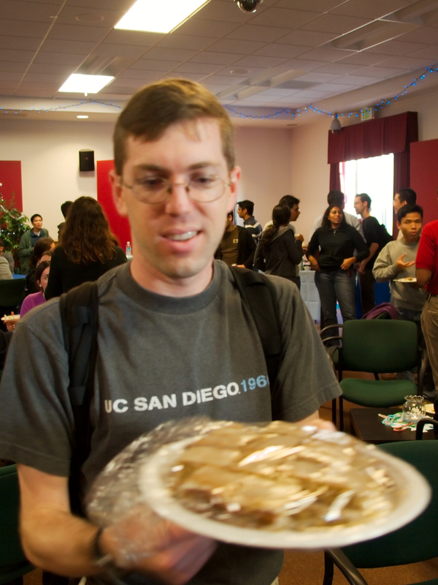
With special thanks to
Notes:
With special thanks to the misc statistics czar

Slide 3
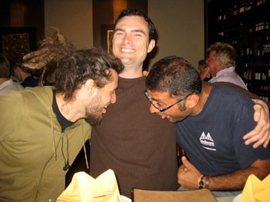
Most time wasted (individual)
Notes:
134 messages sent

Slide 4
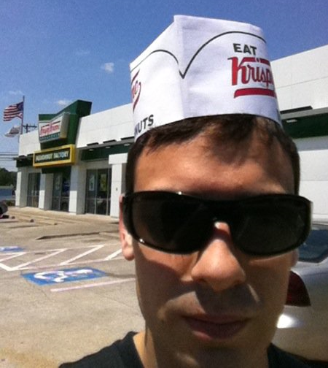
Most time wasted (team)
Notes:
224 messages in response to threads started by this poster, 2nd place was at 130

Slide 6
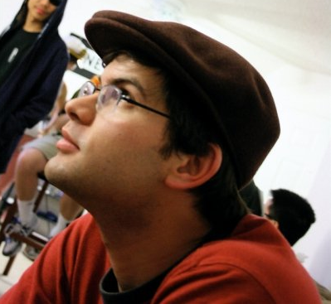
Most time saved
Notes:
23 threads ended, gary at 22, alden at 19

Slide 7
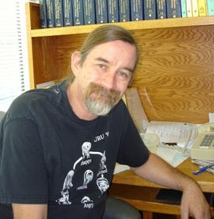
Most time wasted (faculty)
Notes:
92 msgs, stefan in 2nd with 74 msgs

Slide 8
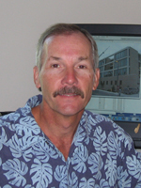
Most problems fixed (staff)
Notes:
92 msgs, stefan in 2nd with 74 msgs

Slide 9
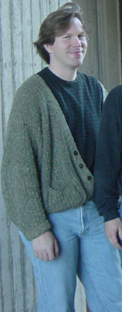
Most time wasted (faculty, verbosity division)
Notes:
107KB, 25% ahead of #2 (gary)

Slide 10
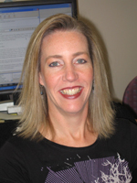
Most trees felled in the forest
Notes:
33 no-reply threads started, 2nd gary w/23

Slide 11
Shortest username

Slide 12
Most vanity URLs

Slide 13
Crankiest pants

Slide 14
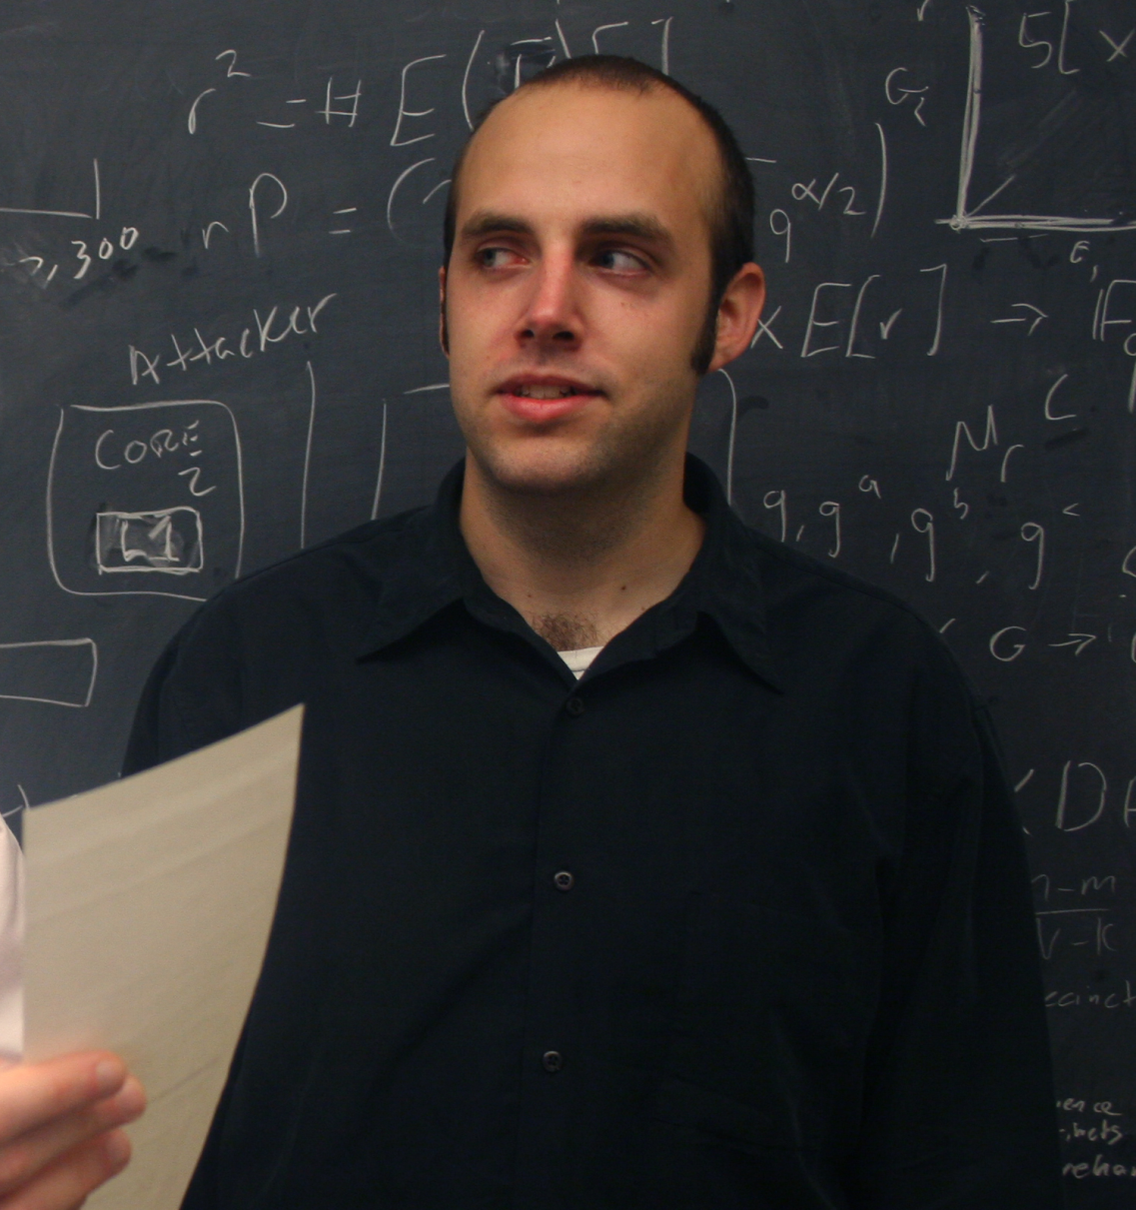
KING OF MISC

