Slide 1
CSE News Network Evening News with Hovav Shacham

Slide 2
LogicGate

Slide 3
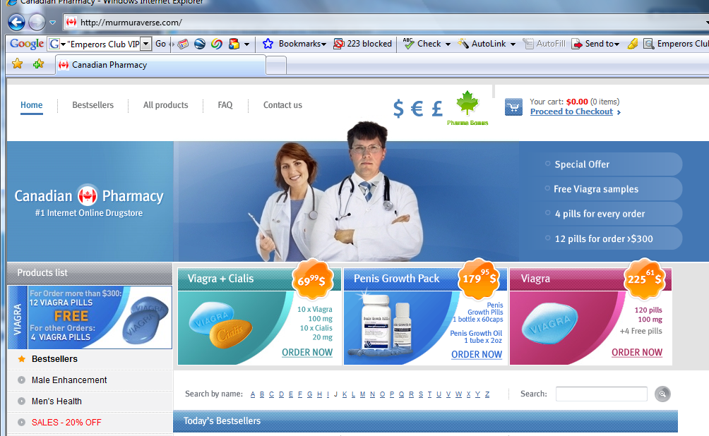
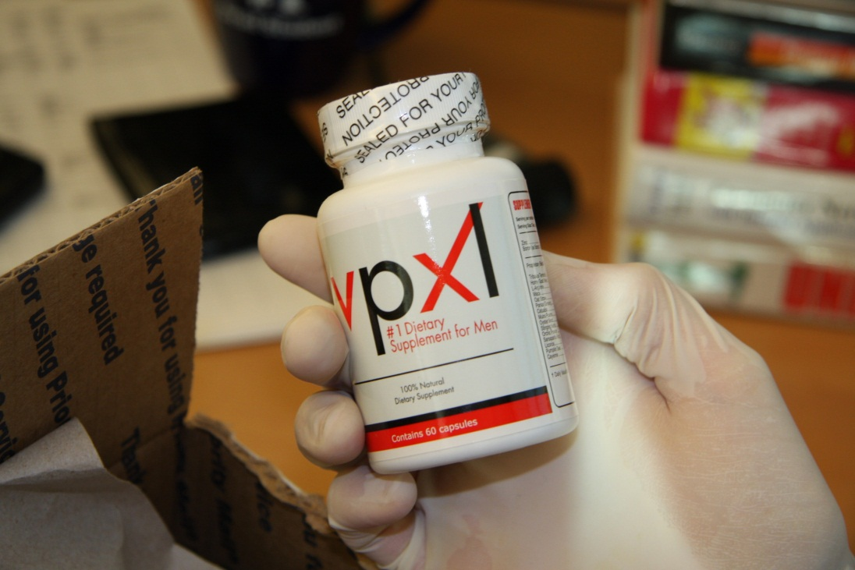

Slide 4
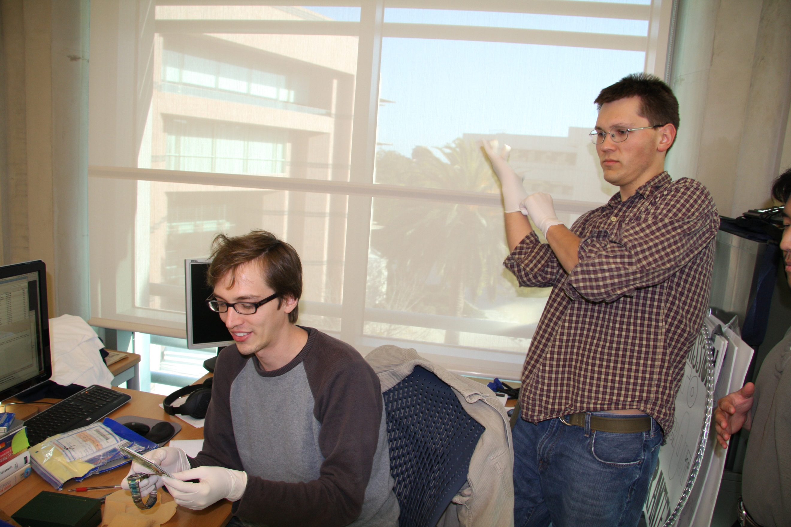
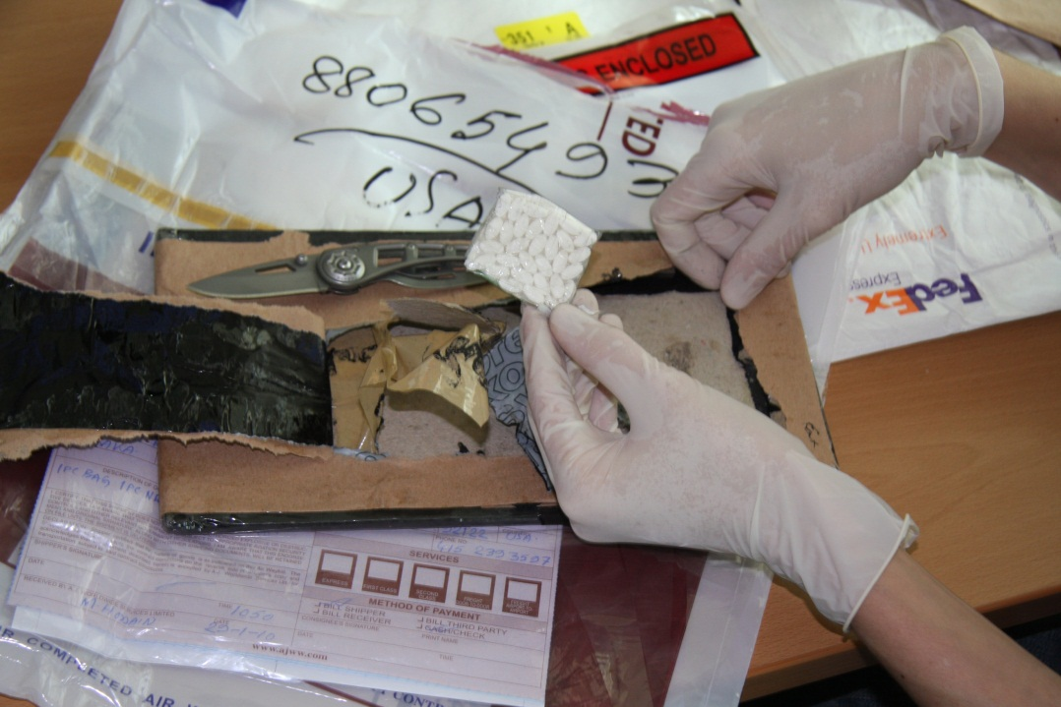

Slide 5
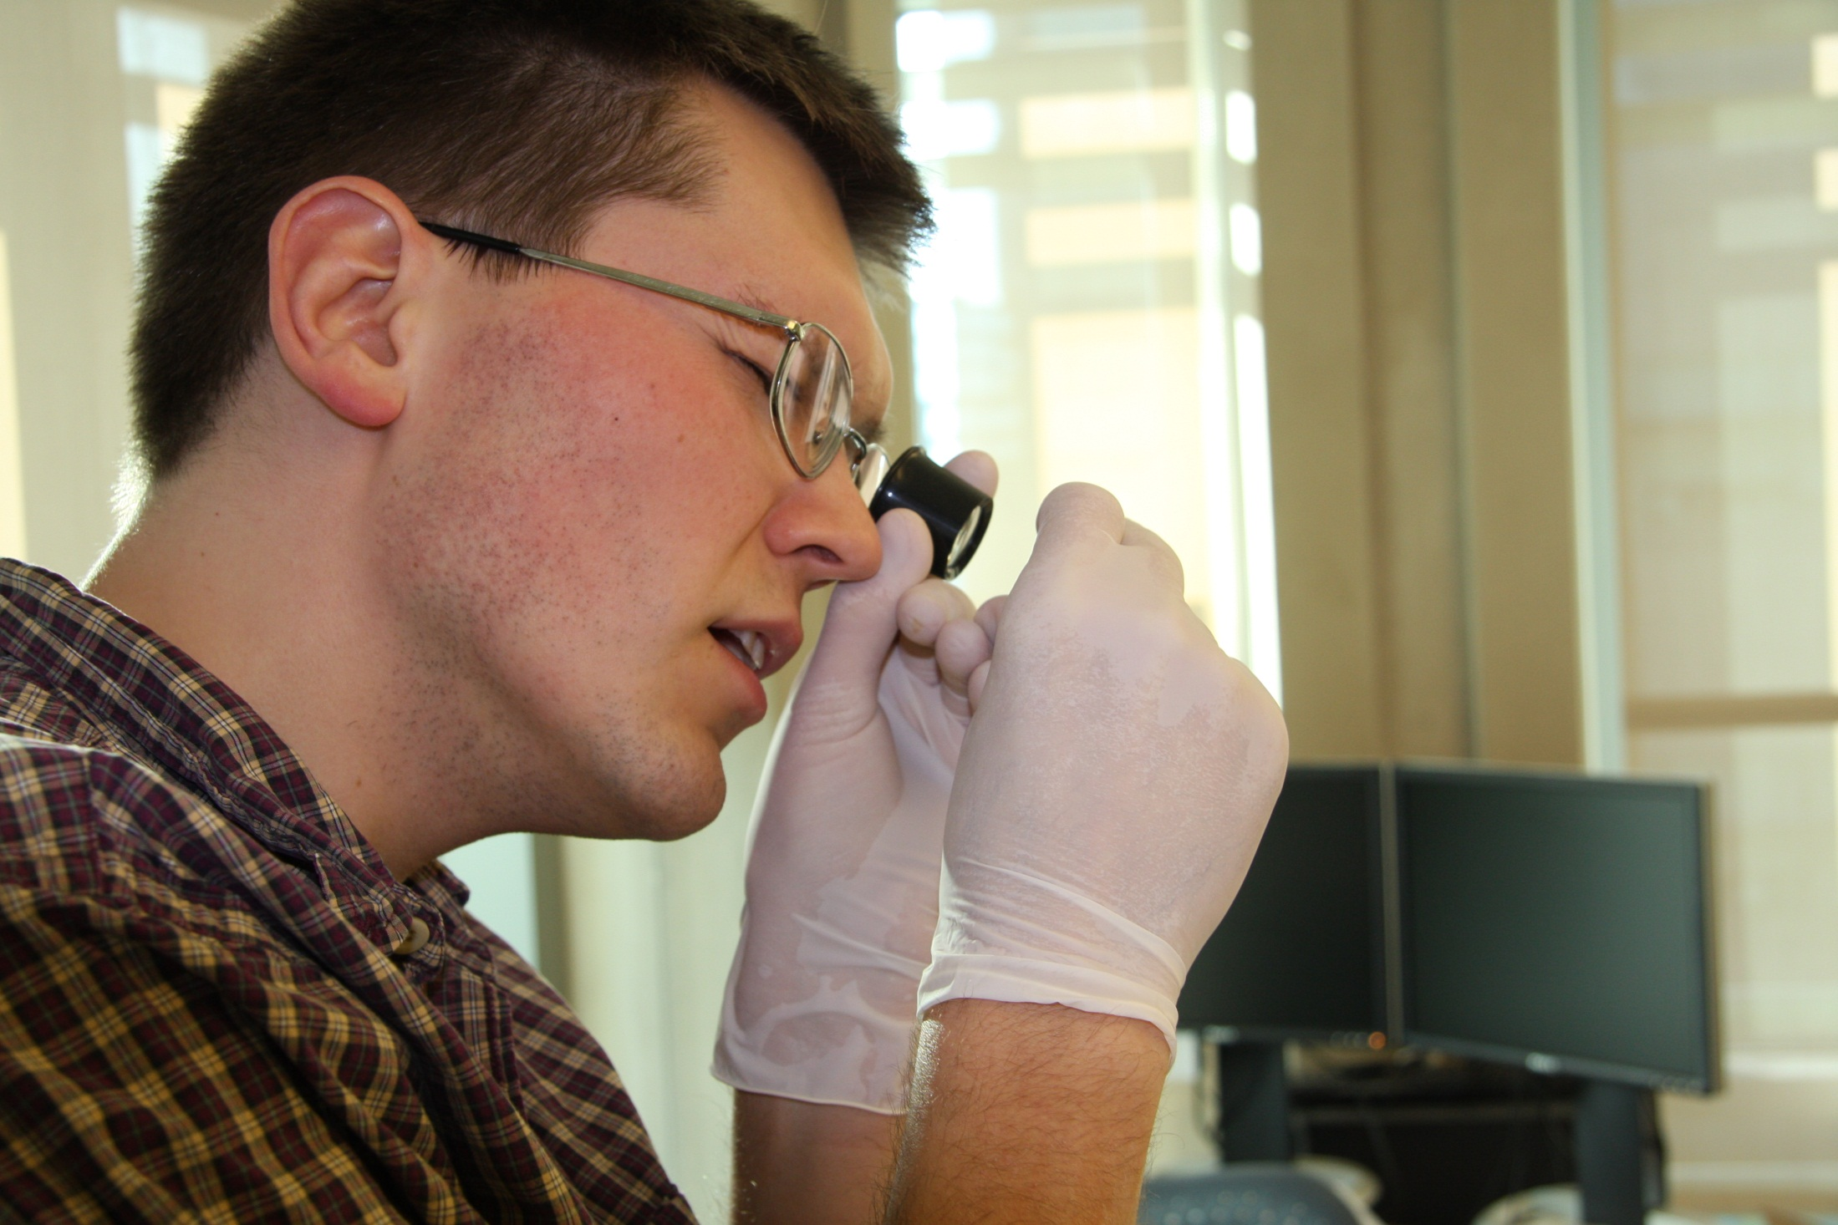

Slide 6
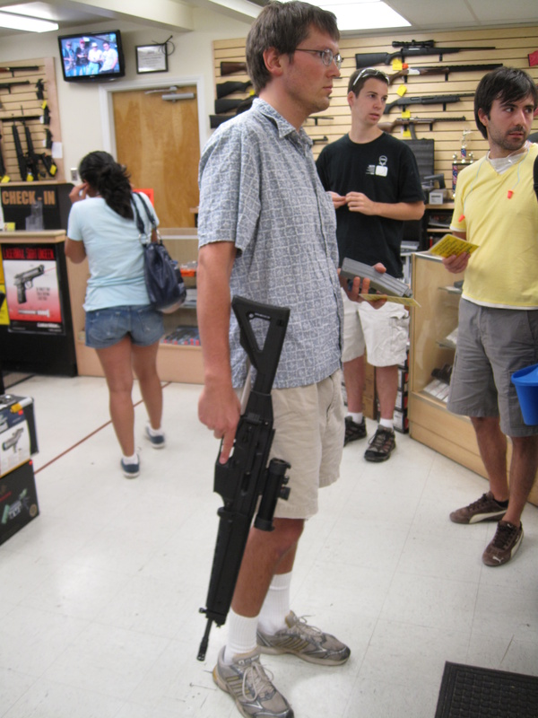

Slide 7
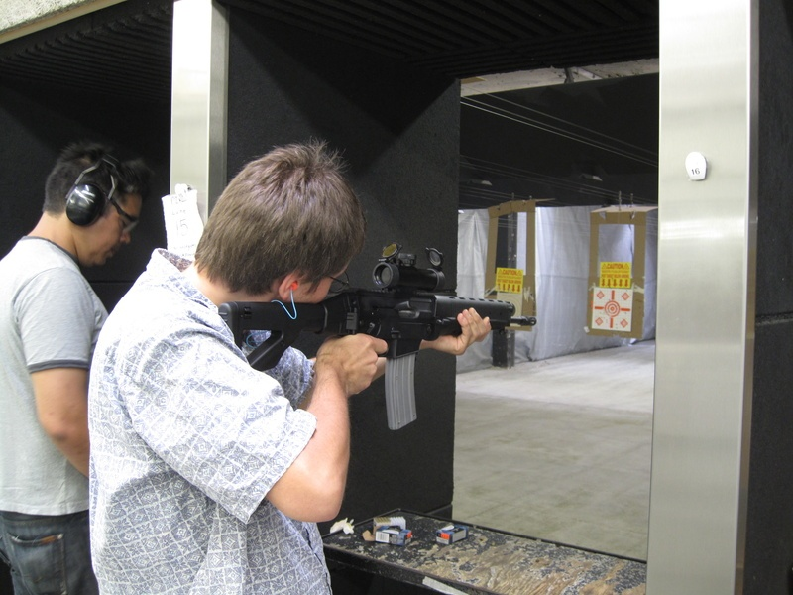

Slide 8
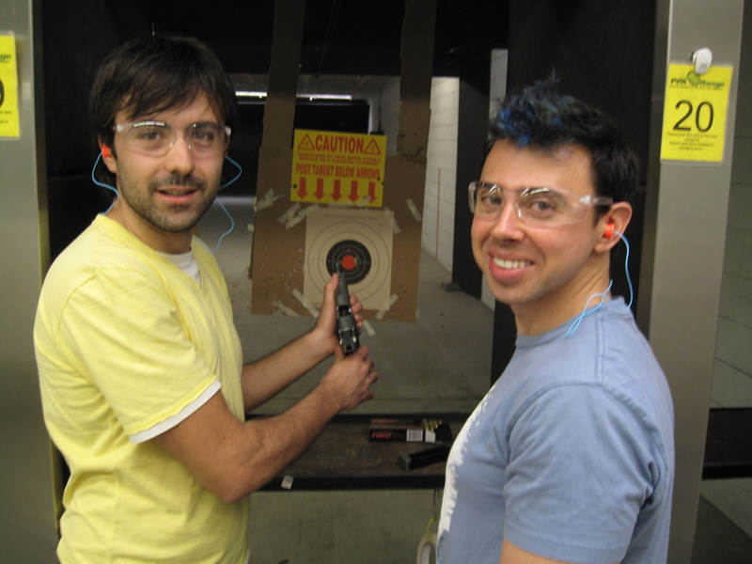

Slide 9
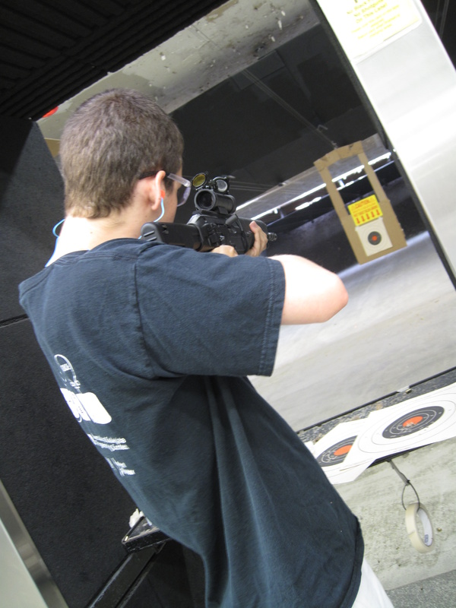

Slide 10
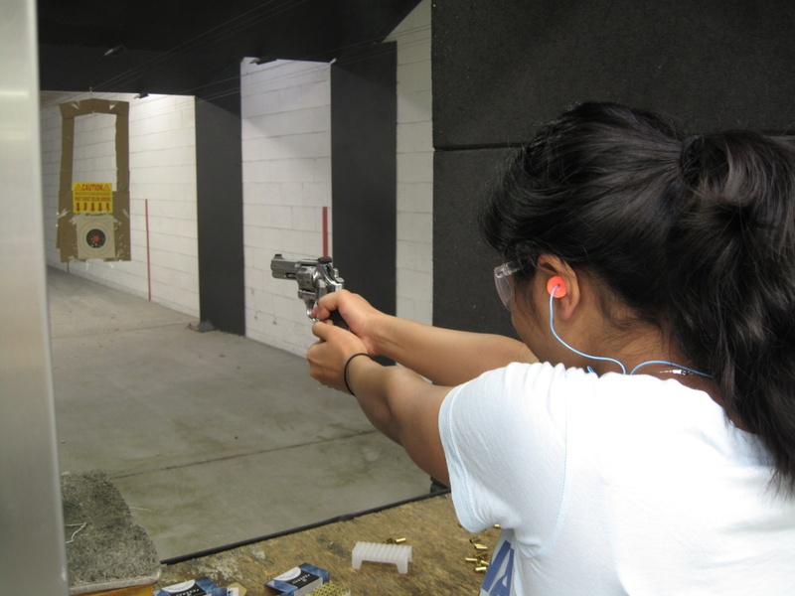

Slide 11
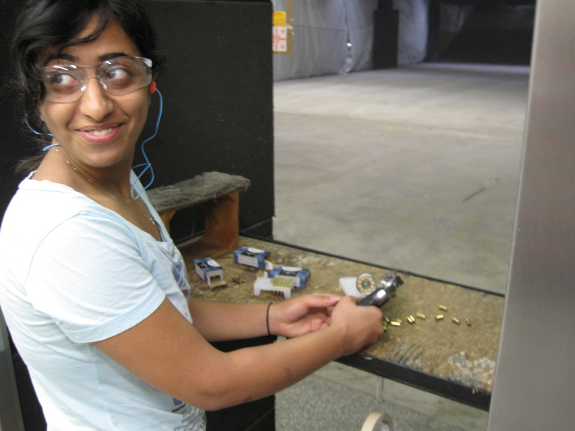

Slide 12
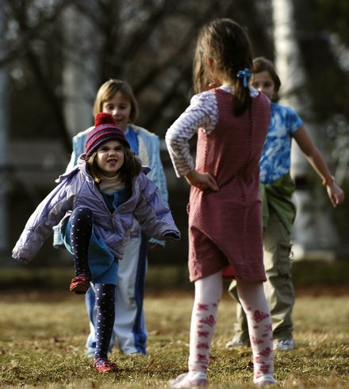
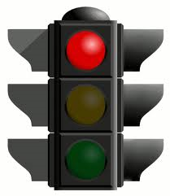
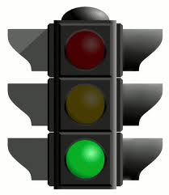
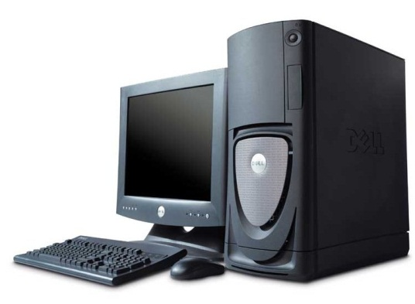
Project Redlight/Greenlight

Slide 13
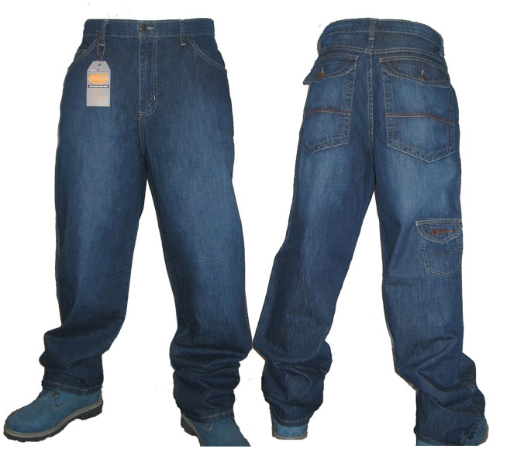
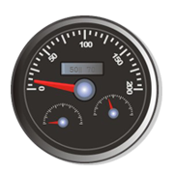
Automatic Wallet
Containment
Zipper Override
Rear-Pocket
Control Unit
Transmission
Communications Fabric
Flexsion Driver
Communications Fabric
http://isstevewearinghiscrankypants.info/
Foot Interface

Slide 15
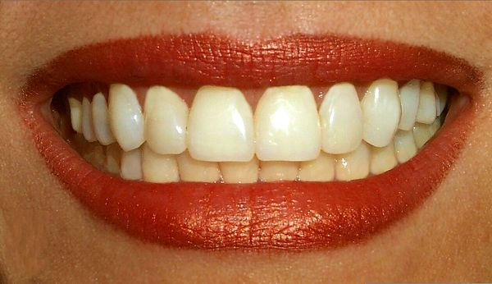
Photorealistic teeth rendering

Slide 16
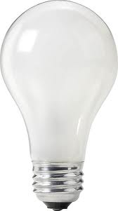
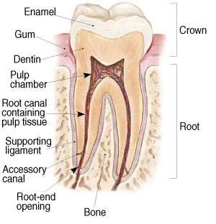
Rendering Teeth
Specular reflection
Dentin interface refraction
Forward scattering
Pulp frequency shift
Light source
Internal scattering

Slide 18
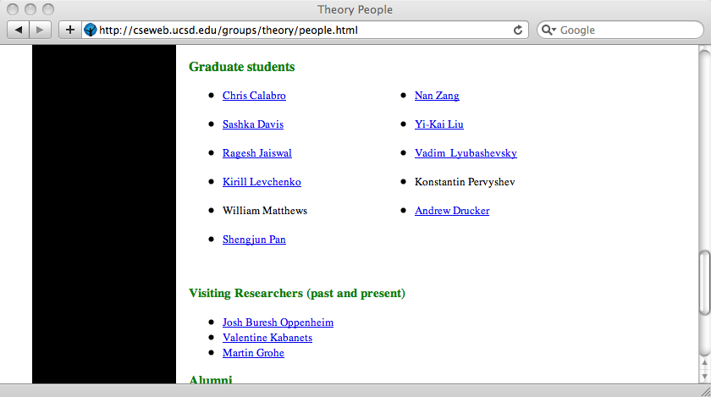

Slide 19
CSE News Network Evening News with Hovav Shacham

